Slide 1

Welcome to our presentation
Group 37
Vũ Hoàng Nam | ITITIU19033
Nguyễn Đức Công | ITITIU19087
Nguyễn Hoàng Anh Tuấn | ITITIU19233

Slide 2

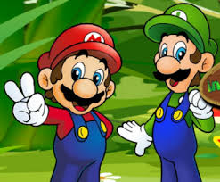
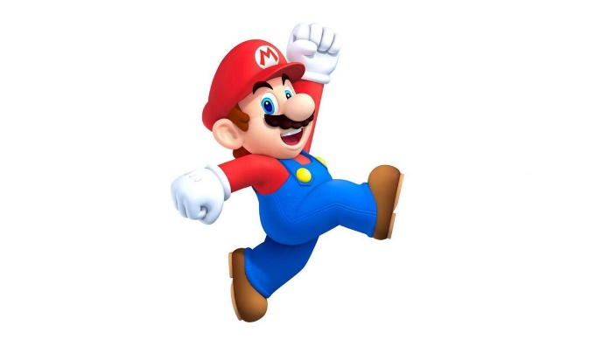
Project Game
Super Mario

Slide 3
About the project:
Involvement of one player
Control the Mario to put bomb kill enemy to gain scores

Slide 4
List of features:
Delightful character
Standard music
Definitive background
Text field to show scores and levels
Button to perform actions

Slide 5
Technology Used:
Swing.
AWT(Abstract Windowing Toolkit)

Slide 6
Some libraries and packages used:
For Painting on the Frame:

Slide 9
Lessons from the project:
Having the potential to accomplish the project
Programming language used : Java
Creativity in the design of the game
Development of the coding skills

